Slide 1
NewsFlash!!
Earth Simulator no longer #1

Slide 2


Slide 3
In slightly less earthshaking news…
Homework #1 due date postponed to 10/11

Slide 4
OpenMP Overview: What is OpenMP?
Model for parallel programming
Shared-memory parallelism
Portable across shared-memory architectures
Scalable
Incremental parallelization
Compiler based
Extensions to existing programming languages
  mainly by directives
  a few library routines
Fortran and C/C++ binding
Supports data parallelism

Slide 5
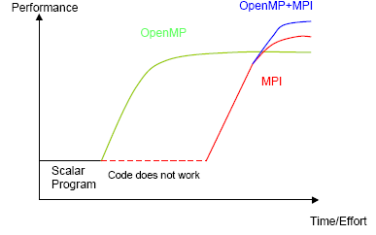
Motivation: why should I use OpenMP?

Slide 6
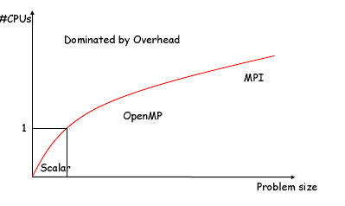
Where should I use OpenMP?

Slide 7
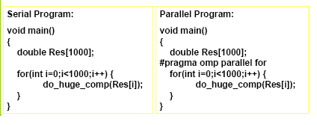
Simple OpenMP Program
Most OpenMP constructs are compiler directives or pragmas
The focus of OpenMP is to parallelize loops
OpenMP offers an incremental approach to parallelism

Slide 8
Outline
Standardization Body: Who owns OpenMP?
• OpenMP Application Program Interface (API)
• Execution Model
  – Parallel regions: team of threads
  – Syntax
  – Data environment (part 1)
  – Environment variables
  – Runtime library routines
• Work-sharing directives
  – Which thread executes which statement or operation?
  – Synchronization constructs, e.g., critical sections
• Data environment and combined constructs
  – Private and shared variables
  – Combined parallel work-sharing directives
• Summary of OpenMP API

Slide 9
OpenMP Information
OpenMP Homepage: http://www.openmp.org/
OpenMP sources on course webpage:
A User's Guide to MPI by Peter Pacheco (pdf)
Introduction to OpenMP - tutorial from WOMPEI 2000 (link)
Writing and Tuning OpenMP Programs on Distributed Shared Memory Machines (link)
R.Chandra, L. Dagum, D. Kohr, D. Maydan, J. McDonald, R. Menon:
Parallel programming in OpenMP.
Academic Press, San Diego, USA, 2000, ISBN 1-55860-671-8
R. Eigenmann, Michael J. Voss (Eds):
OpenMP Shared Memory Parallel Programming.
Springer LNCS 2104, Berlin, 2001, ISBN 3-540-42346-X

Slide 10
OpenMP Programming Model
OpenMP is a shared memory model.
• Workload is distributed between threads
  – Variables can be
    • shared among all threads
    • duplicated for each thread
  – Threads communicate by sharing variables
    • Unintended sharing of data can lead to race conditions:
  – race condition: when the program’s outcome changes as the
threads are scheduled differently.
• To control race conditions:
  – Use synchronization to protect data conflicts.
• Careless use of synchronization can lead to dead-locks

Slide 11
OpenMP Execution Model
Fork-join model of parallel execution
• Begin execution as a single process (master thread)
• Start of a parallel construct:
  Master thread creates team of threads
• Completion of a parallel construct:
  Threads in the team synchronize:
implicit barrier
• Only master thread continues execution

Slide 12
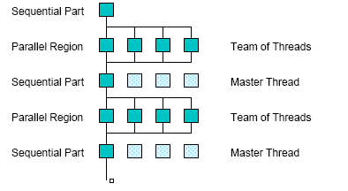
OpenMP Execution Model

Slide 13
OpenMP parallel region construct
Block of code to be executed by multiple threads in parallel
Each thread executes the same code redundantly!
• C/C++:
#pragma omp parallel [ clause [ clause ] ... ] new-line
structured-block
• clause can be one of the following:
private( list)
shared( list)

Slide 14
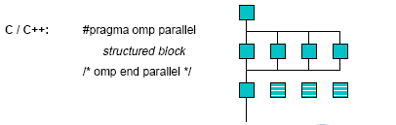
OpenMP parallel region construct

Slide 15
OpenMP directive format C
#pragma directives
• Format:
#pragma omp directive_name [ clause [ clause ] ... ] new-line
• Conditional compilation
#ifdef _OPENMP
  block,
  e.g., printf(“%d avail.processors\n”,omp_get_num_procs());
#endif
• case sensitive
• Include file for library routines:
  #ifdef _OPENMP
  #include <omp.h>
  #endif

Slide 16
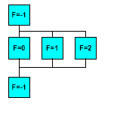
OpenMP data scope clauses
private ( list )
Declares the variables in list to be private to
each thread in a team
shared ( list )
Makes variables that appear in list shared
among all the threads in a team
• If not specified: default shared, but
– stack (local) variables in called sub-programs are
PRIVATE
– Loop control variable of parallel OMP
• DO (Fortran)
• for (C)
is PRIVATE

Slide 17
OpenMP environment variables
OMP_NUM_THREADS
  – sets the number of threads to use during execution
  – when dynamic adjustment of the number of threads is enabled,
  the value of this environment variable is the maximum number
  of threads to use
setenv OMP_NUM_THREADS 16 [csh, tcsh]
export OMP_NUM_THREADS=16 [sh, ksh, bash]
OMP_SCHEDULE
  – applies only to do/for and parallel do/for directives that
  have the schedule type RUNTIME
  – sets schedule type and chunk size for all such loops
setenv OMP_SCHEDULE GUIDED,4 [csh, tcsh]
export OMP_SCHEDULE= GUIDED,4 [sh, ksh, bash]

Slide 18
OpenMP runtime library
Query functions
• Runtime functions
  – Run mode
  – Nested parallelism
• Lock functions
• C/C++: add #include <omp.h>

Slide 19
OpenMP runtime library
omp_get_num_threads Function
Returns the number of threads currently in the team executing the parallel region from which it is called
– C/C++:
int omp_get_num_threads(void);
omp_get_thread_num Function
Returns the thread number, within the team, that lies between 0 and omp_get_num_threads()-1, inclusive. The master thread of the team is thread 0
– C/C++:
int omp_get_thread_num(void);

Slide 20
Work sharing directives
Which thread executes which statement or operation?
• and when?
  – Work-sharing constructs
  – Master and synchronization constructs
• i.e., organization of the parallel work!!!

Slide 21
OpenMP work sharing constructs
Divide the execution of the enclosed code region among the members of the team
• Must be enclosed dynamically within a parallel region
• They do not launch new threads
• No implied barrier on entry
  sections directive
  do directive (Fortran)
  for directive (C/C++)

Slide 22
OpenMP sections directive
Several blocks are executed in parallel
• C/C++:
#pragma omp sections [ clause [ clause ] ... ] new-line
{
[#pragma omp section new-line ]
structured-block1
[#pragma omp section new-line
structured-block2 ]
...
}

Slide 23
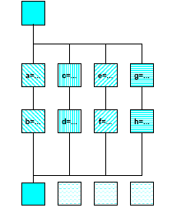
OpenMP sections directive
#pragma omp parallel
{
#pragma omp sections
{{ a=...;
b=...; }
#pragma omp section
{ c=...;
d=...; }
#pragma omp section
{ e=...;
f=...; }
#pragma omp section
{ g=...;
h=...; }
} /*omp end sections*/
} /*omp end parallel*/

Slide 24
OpenMP for directive
Immediately following loop executed in parallel
• C/C++:
#pragma omp for [ clause [ clause ] ... ] new-line
for-loop

Slide 25
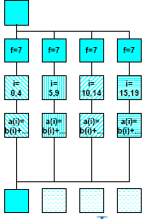
OpenMP for directive
#pragma omp parallel private(f)
{
f=7;
#pragma omp for
for (i=0; i<20; i++)
a[i] = b[i] + f * (i+1);
} /* omp end parallel */

Slide 26
OpenMP for directive
clause can be one of the following:
private( list) [see later: Data Model]
reduction( operator: list) [see later: Data Model]
schedule( type [ , chunk ] )
nowait (C/C++: on #pragma omp for)
• Implicit barrier at the end of do/for unless nowait is specified
• If nowait is specified, threads do not synchronize at the end of the
parallel loop
schedule clause specifies how iterations of the loop are divided
among the threads of the team.
– Default is implementation dependent

Slide 27
OpenMP schedule clause
Within schedule( type [ , chunk ] ) type can be one of the following:
static: Iterations are divided into pieces of a size specified by chunk.
The pieces are statically assigned to threads in the team in a roundrobin
fashion in the order of the thread number.
Default chunk size: one contiguous piece for each thread.
dynamic: Iterations are broken into pieces of a size specified by chunk.
As each thread finishes a piece of the iteration space, it dynamically
obtains the next set of iterations. Default chunk size: 1.
guided: The chunk size is reduced in an exponentially decreasing
manner with each dispatched piece of the iteration space.
chunk specifies the smallest piece (except possibly the last).
Default chunk size: 1. Initial chunk size is implementation dependent.
runtime: The decision regarding scheduling is deferred until run time.
The schedule type and chunk size can be chosen at run time by setting
the OMP_SCHEDULE environment variable.
Default schedule: implementation dependent.

Slide 28
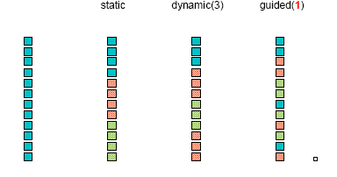
Loop scheduling

Slide 29
OpenMP synchronization
Implicit Barrier
  – beginning and end of parallel constructs
  – end of all other control constructs
  – implicit synchronization can be removed
  with nowait clause
• Explicit
critical

Slide 30
OpenMP critical directive
Enclosed code
– executed by all threads, but
– restricted to only one thread at a time
• C/C++:
#pragma omp critical [ ( name ) ] new-line
structured-block
• A thread waits at the beginning of a critical region until no other
thread in the team is executing a critical region with the same name.
All unnamed critical directives map to the same unspecified
name.

Slide 31
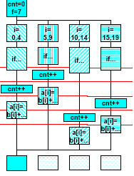
OpenMP critical
C / C++: cnt = 0;
f=7;
#pragma omp parallel
{
#pragma omp for
for (i=0; i<20; i++) {
if (b[i] == 0) {
#pragma omp critical
cnt ++;
} /* endif */
a[i] = b[i] + f * (i+1);
} /* end for */
} /*omp end parallel */

Slide 32
OpenMP control structures -summary
Parallel region construct
  parallel
• Work-sharing constructs
  sections
  do (Fortran)
  for (C/C++)
• Combined parallel work-sharing constructs [see later]
  parallel do (Fortran)
  parallel for (C/C++)
• Synchronization constructs
  critical

Slide 33
OpenMP data scope clauses
private ( list )
Declares the variables in list to be private to each thread in a team
shared ( list )
Makes variables that appear in list shared among all the threads in
a team
• If not specified: default shared, but
  – stack (local) variables in called subroutines are PRIVATE
  – Automatic variables within a block are PRIVATE
– Loop control variable of parallel OMP
• DO (Fortran)
• FOR (C)
is PRIVATE

